Slide 1



Authorship, ownership, and subject-matter
Copyright in the Digital Environment
Amy Thomas
21 January 2026

Slide 2
Format: 21 January
i.e., ‘Copyright subsistence’
The author + the work
Subject-matter (incl. idea/expression)
Fixation
Originality
Authorship v ownership
Note on readings: paras 3.47 - 3.85 of the textbook were excluded this week, but may be useful for revision (subject-matter deep dives)

Slide 3

The ‘author’
Recap from last class: copyright is the law that regulates creativity and (its) creators.
Think of an example of something (past or present) which you consider to be particularly creative.
Is the person(s) who made this creative thing an ‘author’ in the copyright sense?
If not, why not?
NB: This is today’s participation activity
https://forms.cloud.microsoft/e/7VM3HKga9b

Slide 4
The ‘author’
International | e.g. Berne Convention; TRIPS | Broad, high-level principles | Berne Art 1: … ‘Protection of the rights of authors’
Multi-lateral | e.g. EU Directives | Often driven by trade agreements (e.g., a single market) | Infosoc Art 9: ‘Any harmonisation of copyright and related rights must take as a basis a high level of protection, since such rights are crucial to intellectual creation.’
National | e.g. Copyright, Designs and Patents Act 1998 AND Common law | Specifics | CDPA Art 9(1): ‘“author”, in relation to a work, means the person who creates it’

Slide 5
The ‘work'
Work falls within list of copyrightable subject-matter + fixed permanently + meets the originality standard = copyright work
Copyright arises automatically when a valid work is created – see Berne Convention (art. 5 (2))
No requirements for formalities of registration or marking (e.g., ©) – note: US registration system ‘bonuses’

Slide 6
Subject-matter: What isn’t a work?
Reverse standard: copyright is very broad, so sometimes it’s more helpful to think in the negative (what isn’t covered)
Copyright does not protect ideas, only the expression of ideas themselves (the idea-expression dichotomy, Berne Convention Article 9.2)
(unlike patent) copyright does not stop others from coming to the same result through an independent process

Slide 7
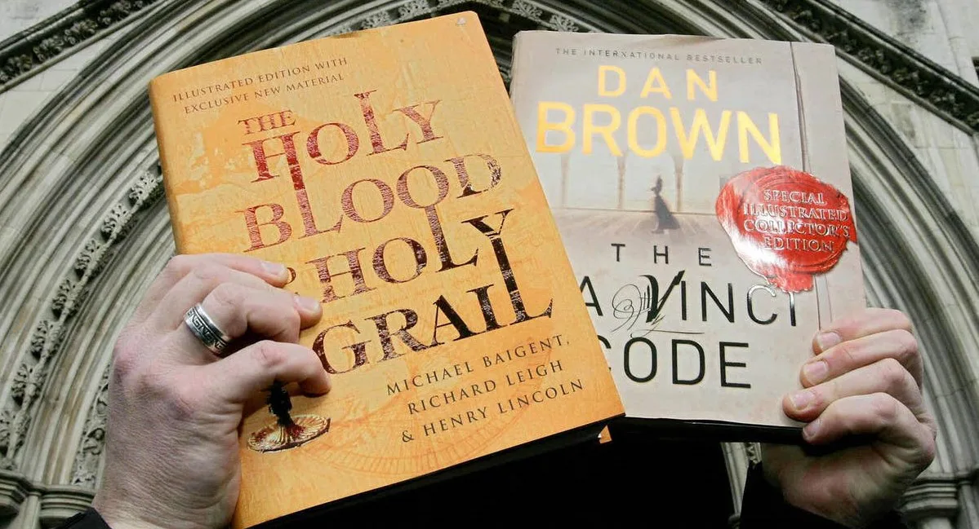
Idea/expression: Example 1
Michael Baigent and Richard Leigh v The Random House Group Limited [2006] EWHC 719
A paradox for authors of non-fiction and factual works
Image Source

Slide 8
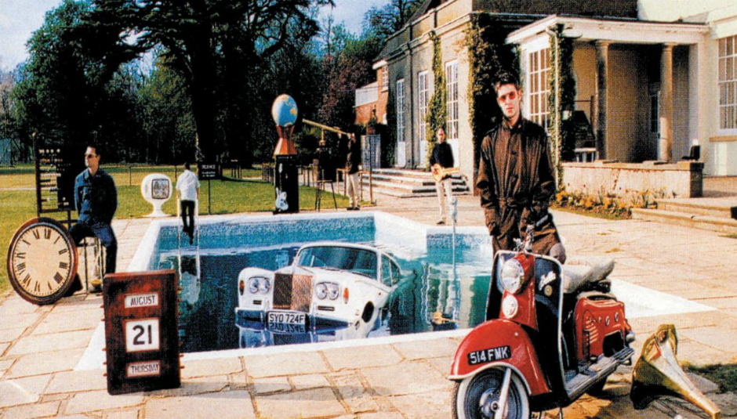
Idea/expression: Example 2
Creation Records Ltd. and Others v News Group Newspapers Ltd [1997] EMLR 444
What alternative forms of law may be useful?
Image Source

Slide 9
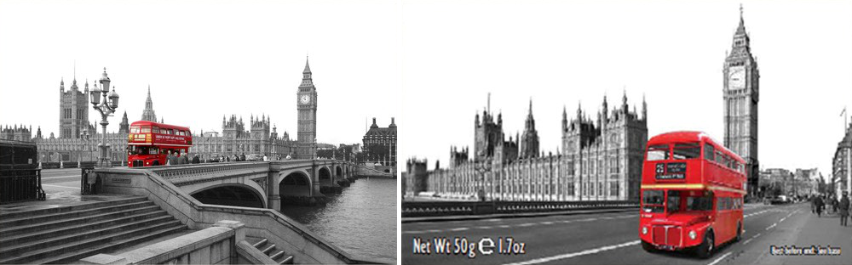
Idea/expression: Example 3
Temple Island Collections Ltd v New English Teas Ltd & another [2012] EWPCC 1
Granting a monopoly on the ‘common elements of everyday life’?
Image Source

Slide 10
The closed list of subject-matter (CDPA s3-8)
Literary works (and computer programmes)
Musical works
Artistic works
Dramatic works
Sound recordings
Films
Broadcasts
Typographical arrangements
Works of artistic craftsmanship
suis generis Database right (Directive 96/9/EC of 11 March 1996 on the legal protection of databases)

Slide 11
The closed list of subject-matter (CDPA s3-8)
Literary works (and computer programmes)
Musical works
Artistic works
Dramatic works
Sound recordings
Films
Broadcasts
Typographical arrangements
Works of artistic craftsmanship
suis generis Database right (Directive 96/9/EC of 11 March 1996 on the legal protection of databases)
‘Secondary’ or ’Entrepreneurial’ works

Slide 12
The closed list of subject-matter (CDPA s3-8)
Literary works (and computer programmes)
Musical works
Artistic works
Dramatic works
Sound recordings
Films
Broadcasts
Typographical arrangements
Works of artistic craftsmanship
suis generis Database right (Directive 96/9/EC of 11 March 1996 on the legal protection of databases)
May also include performers with a distinct set of (neighbouring) rights (Seminar 6)

Slide 13
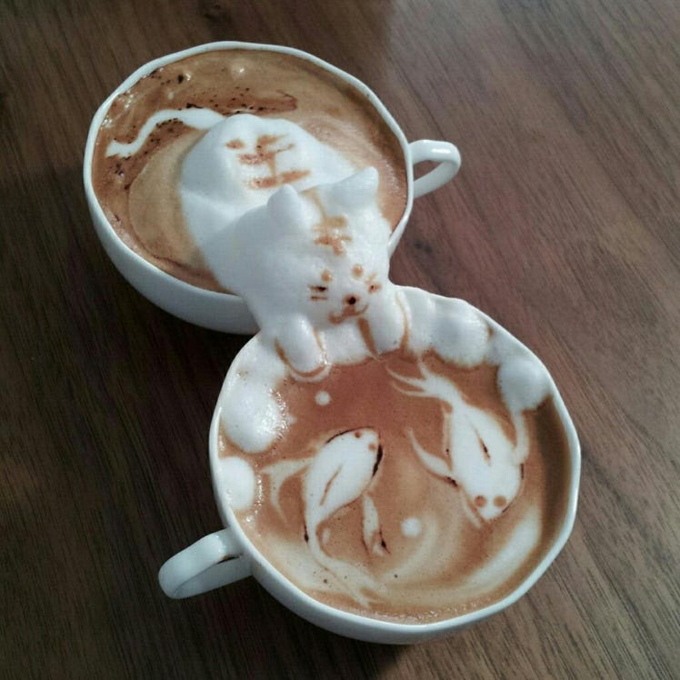
Fixation
Copyright is intangible property...
... but the work must be fixed in a permanent record
Note: principle of digital equivalence
The key question is whether it existed long enough for it ‘to be perceived, reproduced, or otherwise communicated for a period of more than transitory duration’ (Metix v GH Maughan)
Fixation doesn’t necessarily require permanent materialisation
Image Source

Slide 14

Originality
What is the correct legal test for whether something is ‘original’ in UK copyright law?
https://forms.cloud.microsoft/e/ymfhAFFx0S

Slide 15
Originality
Literary and artistic works are only protected by copyright if they are original (Berne Convention, art 2)
Note: does not apply to entrepreneurial works
‘Originality’ is not defined in statute
UK (the ‘old’ test): a work is original if it shows ‘skill, labour and judgement’ (see: University of London Press v. University Tutorial Press)
EU (the ‘new test’): a work is original if it is the ‘author’s own intellectual creation’
Eva-Maria Painer v Standard Verlags GmbH: an author’s ‘formative freedom’ and ability to make ‘free and creative choices’
THJ v Sheridan: affirmed (post-Brexit) that the ‘author’s own intellectual creation’ is the correct test of originality in the UK

Slide 16
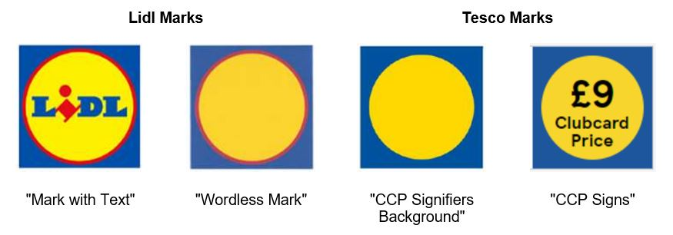
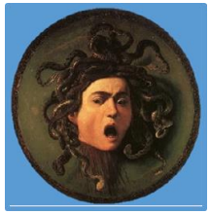
Lidl v Tesco [2024]
‘The shade of blue and the distance between the circle and the square’ [194]
No requirement for artistic merit
Simplicity of design doesn’t preclude originality

Slide 17
Work falls within list of copyrightable subject-matter + fixed permanently + meets the originality standard = copyright work = author

Slide 18
Authorship/ownership
General rule: first owner is the author (CDPA s9 and s11)
… but authorship and ownership are different concepts, and…
… depending on the subject-matter, there may be different rules and automatic allocation.

Slide 19
Authorship/ownership
Type of work | Author/first owner
Literary, dramatic, musical and artistic work | Author
Sound recordings | Producer
Film | Producer and Principal Director
Broadcast | Person making the broadcast
Typographical arrangements of published editions | Publisher
Computer generated works | “person by whom the arrangements necessary for the creation of the work are undertaken”

Slide 20
Authorship/ownership
Works of joint authorship – ‘a work produced by the collaboration of two or more authors in which the contribution of each author is not distinct from that of the other author or authors’. (s10(1) CDPA)
Employment – ‘if the work is made by an employee in the course of his employment, his employer is the first owner of any copyright in the work subject to any agreement to the contrary.’ (s11(2) CDPA) see - Missing Link Software v. Magee)
Commissioned works – absent any agreement to the contrary, the first owner of a commissioned work is the person who carried out the work, not the person who commissioned it (note: difference in US position)
What about students and their work?

Slide 21
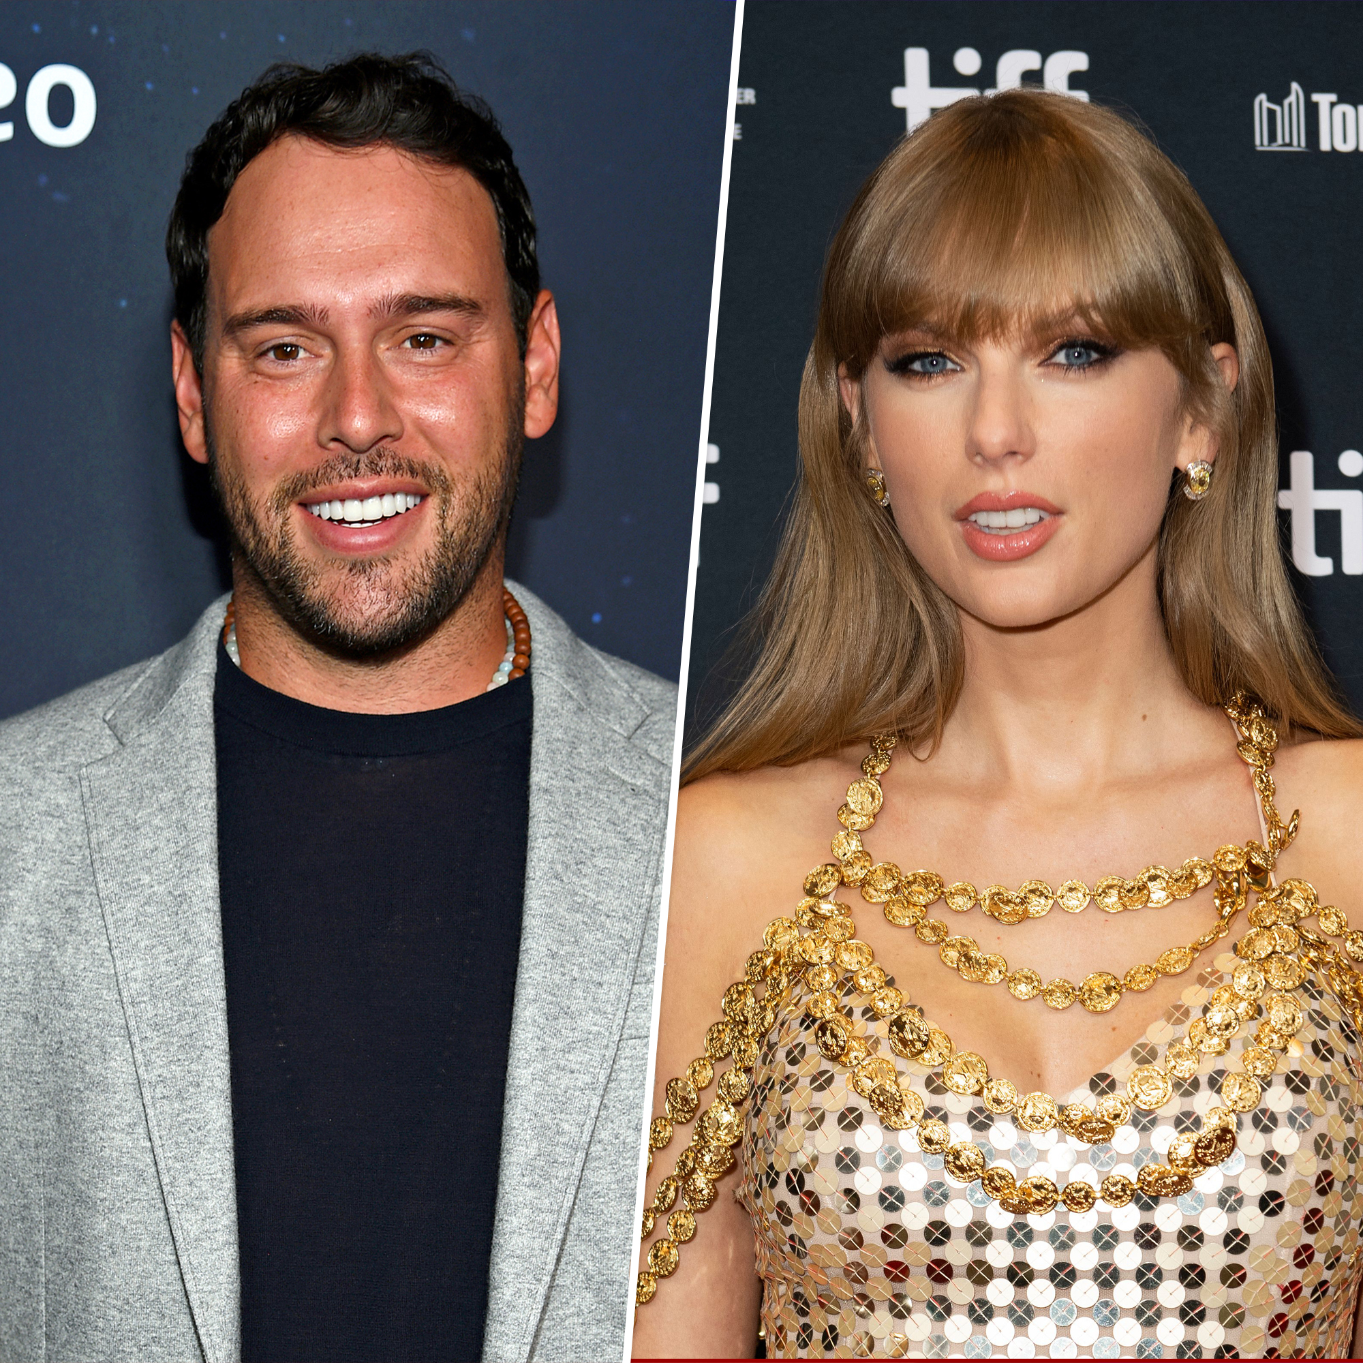
Taylor Swift
Following a dispute with the owner of a record company (Scooter Braun – Big Machine Records), Taylor Swift has re-recorded many of her older songs and is re-releasing them.
How is Taylor (legally) able to do this under copyright law?
Is there any value in her being able to do this (for her as an author/performer and for her fans)?
Image Source

Slide 22

Based on this formula, which of the following do you think has copyright subsistence?
A very short, viral TikTok dance
Art styles and aesthetics (e.g., the ‘Studio Ghibli’ aesthetic)
Game mechanics (e.g., press x to jump)
Your own face! (Danish proposal to tackle deepfakes)
https://forms.cloud.microsoft/e/cf3uZgtdHP

Slide 23

Viral TikTok dance
Subject-matter: Maybe – is it a ‘dramatic work’? (Norowzian v Arks) Was it choreographed? Or is it a ‘building block’?
Fixation: The recording will be; choreography may be written down too
Originality: Yes (Infopaq/Tixdaq cases – length/duration ≠ originality)
Addison Rae/Jimmy Fallon (US): critical race theory
Image Source

Slide 24
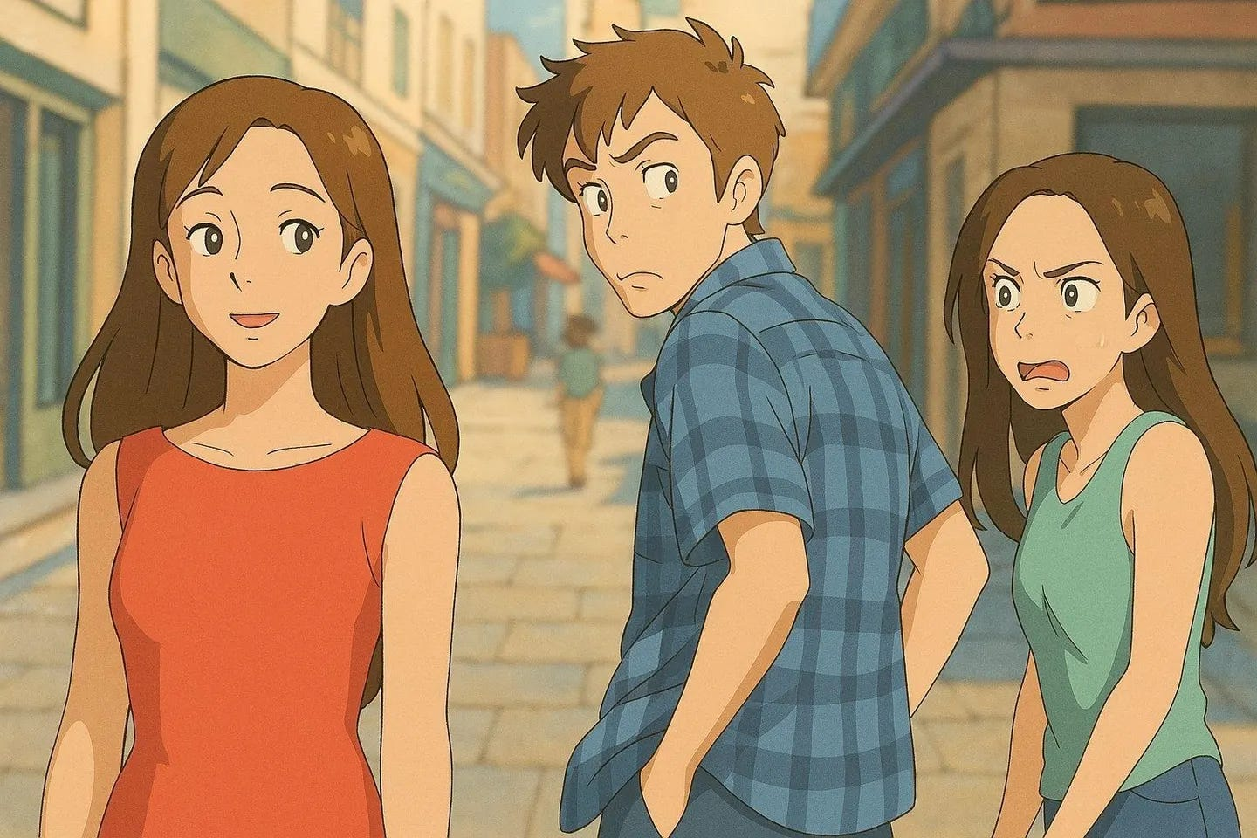
Art aesthetics
Subject-matter: Only the expressive elements in the specific artistic work – not the technique, method, or impression (though Temple Island case might bring this into some doubt)
Fixation: As above
Originality: As above
Image Source

Slide 25

Game mechanics
Subject-matter: Computer-programme/audiovisual elements
Fixation: Yes – recorded, written as code etc.
Originality: Only for the expressive elements (incl. characters – see Shazam v Only Fools) not methods or processes
But - ‘merger’ doctrine: where do the lines between idea and expression blur in interactive works?
Role of TM/patent

Slide 26
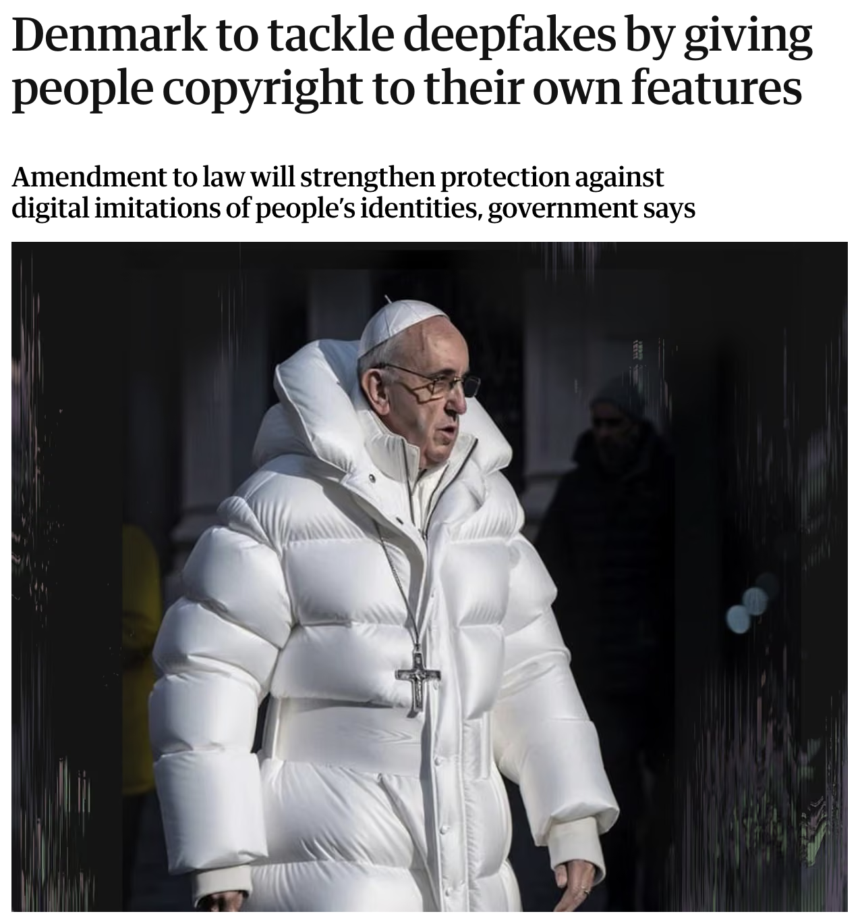
Your own face!
Subject-matter: Not in the UK (an artistic work? A sculpture?)
Fixation: I guess?
Originality: Is it a process of ‘intellectual creation’?
Significance of ‘the closed list’ approach – not every jurisdiction sets limits on what is eligible for protection

Slide 27
Key points of critique
Not all forms of creativity are ‘protected’: the law legitimates and gives exclusive rights to some forms of works and their authors and not others
This may impact their ability to be commodified or exploited by their creators

Slide 28
Next week…
Readings/preparation for next week (Exclusive Rights)
Office hours: Wednesday 1:30 – 2:30pm (amy.thomas@glasgow.ac.uk)

